Slide 1
Facilitating Creativity
Mike Yu, Darby Schumacher, April Yu, Alex Lin

Slide 2
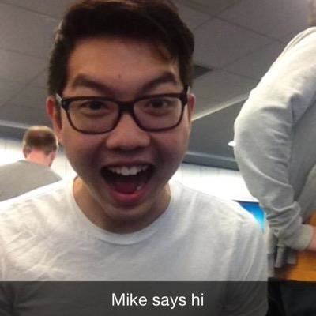
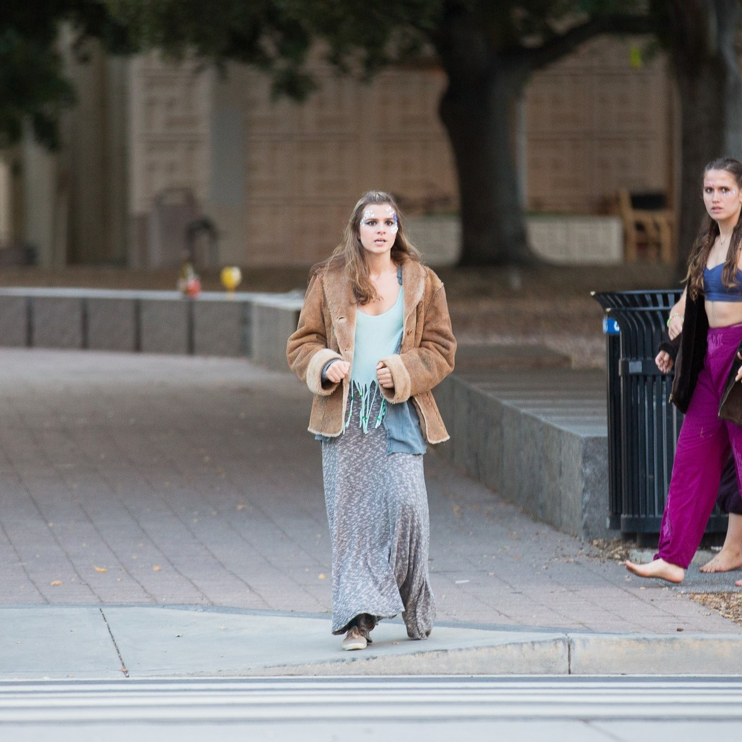
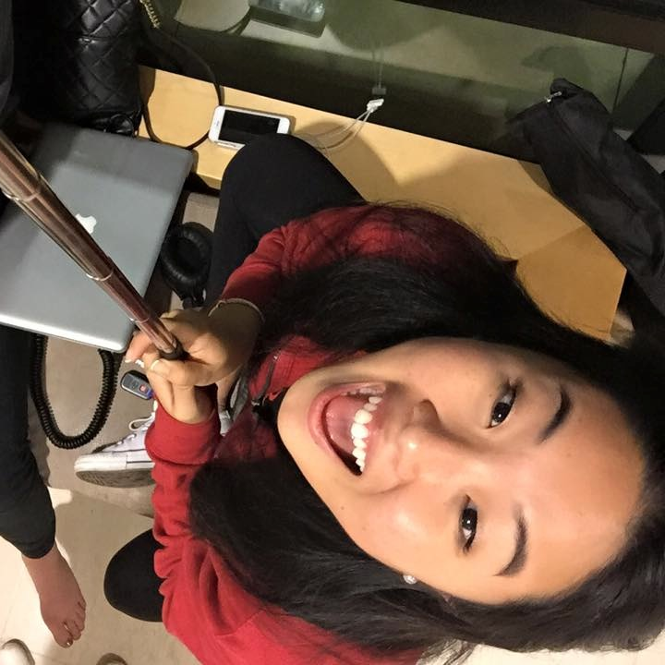
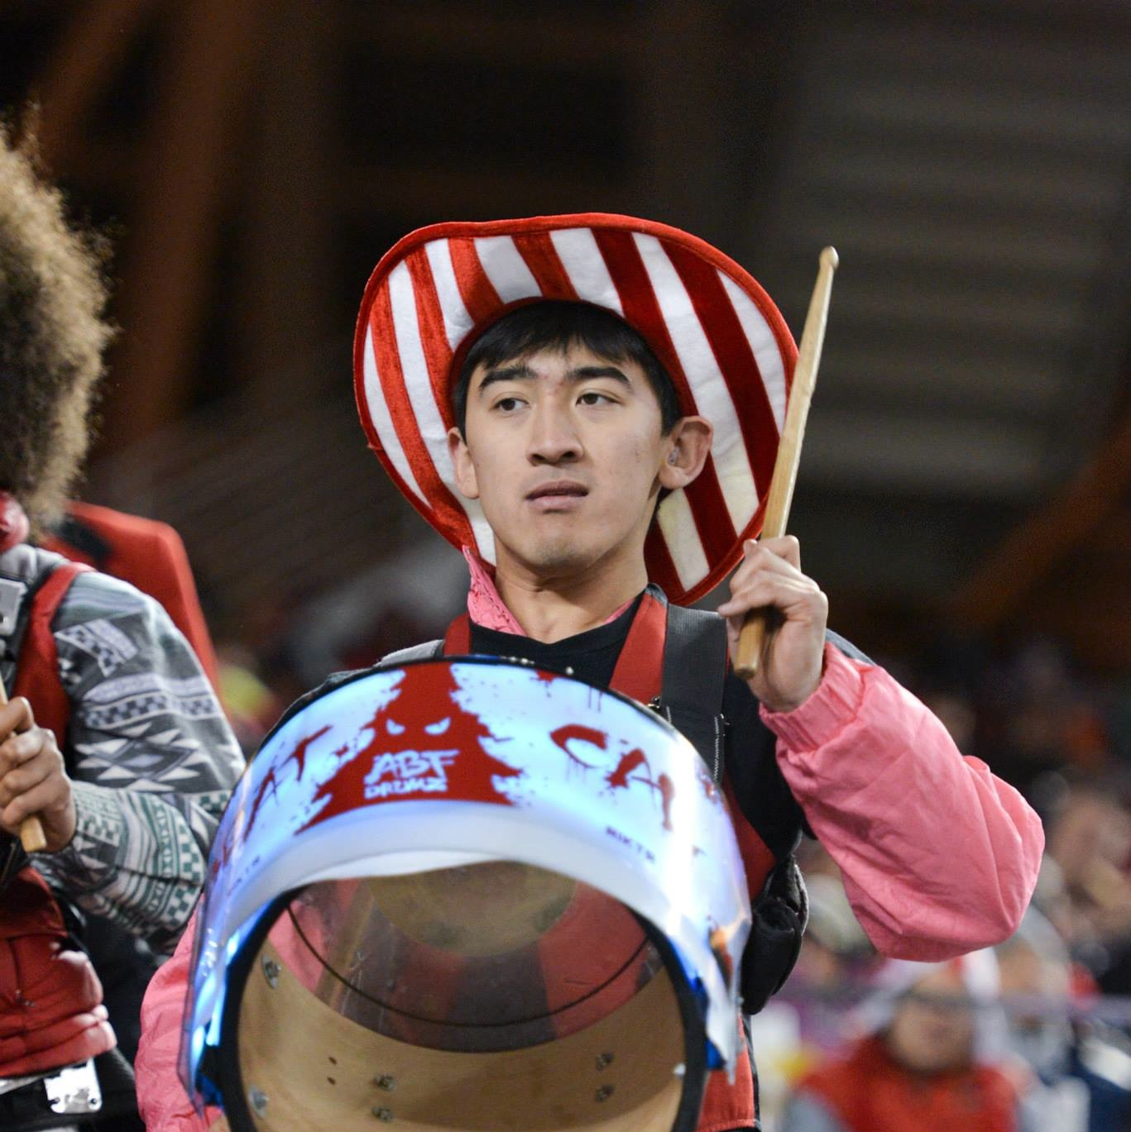
Team:
Mike Yu
Darby Schumacher
April Yu
Alex Lin

Slide 3
Design Problem:
We know: The world is changing fast.
In particular: People move more.
How might we leverage this shift to enable people to be more creative?

Slide 4
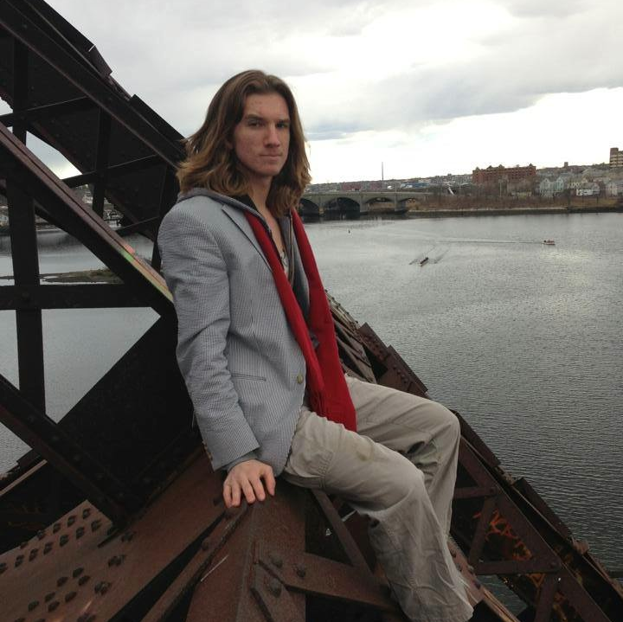
Hayward Gatch
Age: 22
Graphic Designer
“Lots of people spend an atrocious amount of time on Tumblr and Pinterest; a lot of them do ludicrous research.”

Slide 5
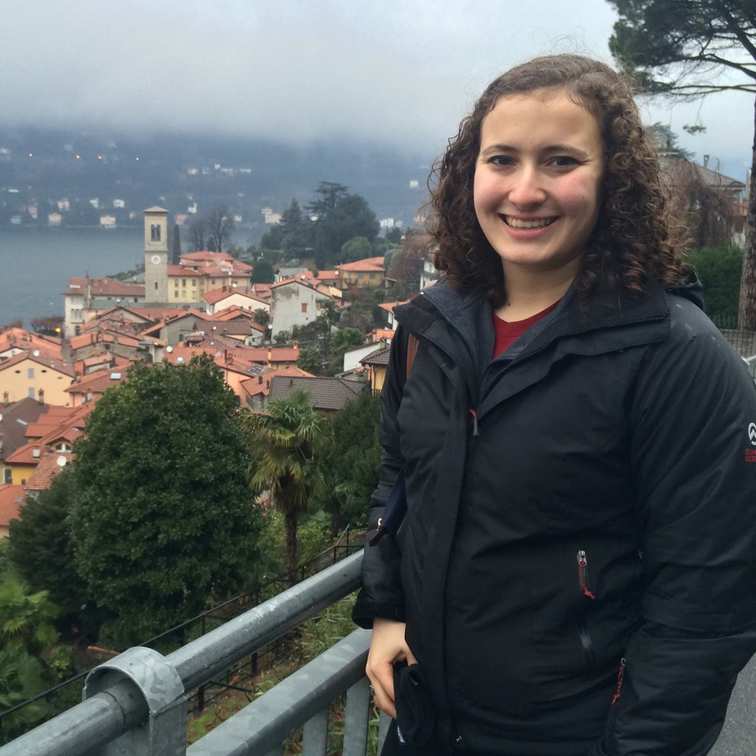
Jenny Astrachan
Age: 22
Software Engineer
“I wish there was a genuine form of content creation and sharing, as opposed to a highly-filtered version of life.”

Slide 6
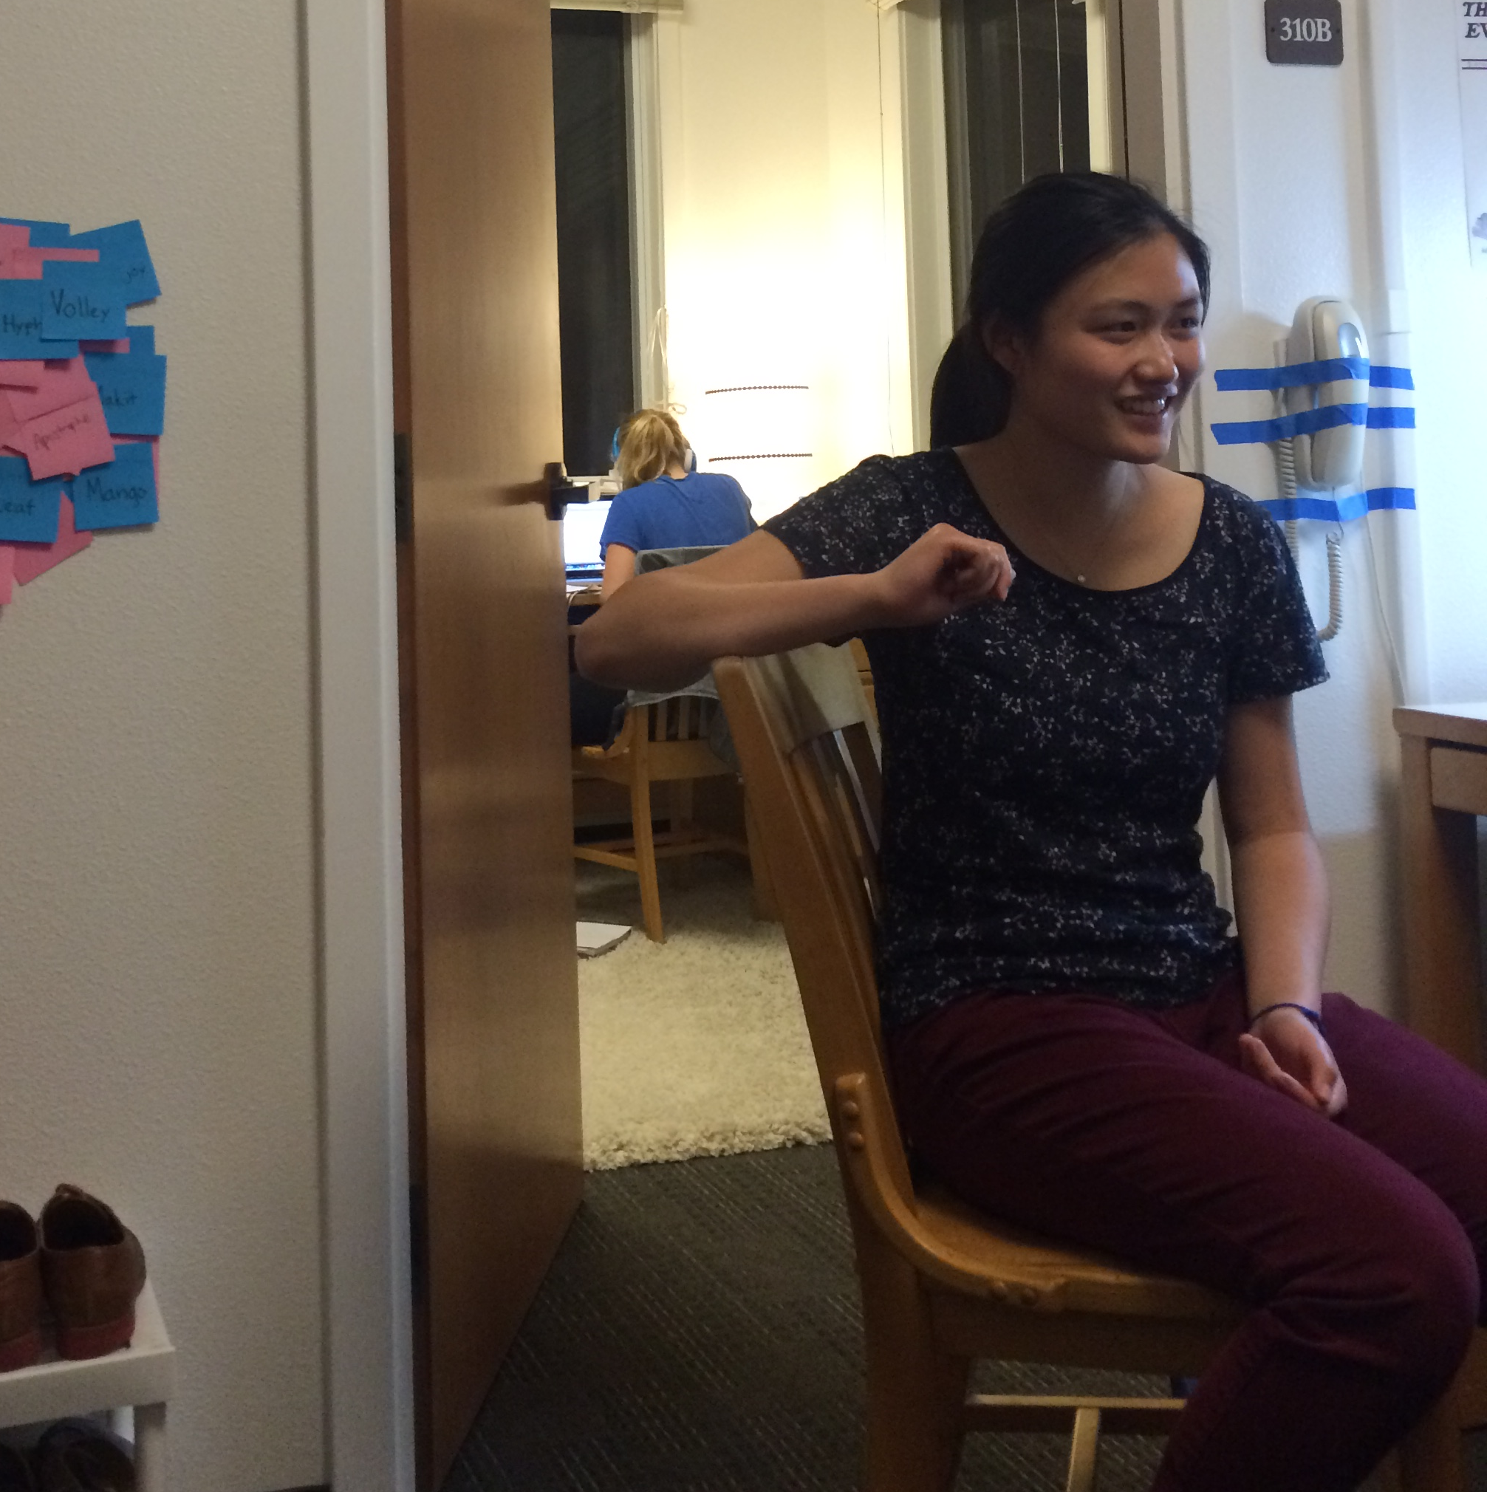
Katherine Liu
Age: 19
Designer
“Sometimes I do want to access pictures in conversation. I know I could use Carousel or Dropbox, but they kind of suck.”

Slide 7
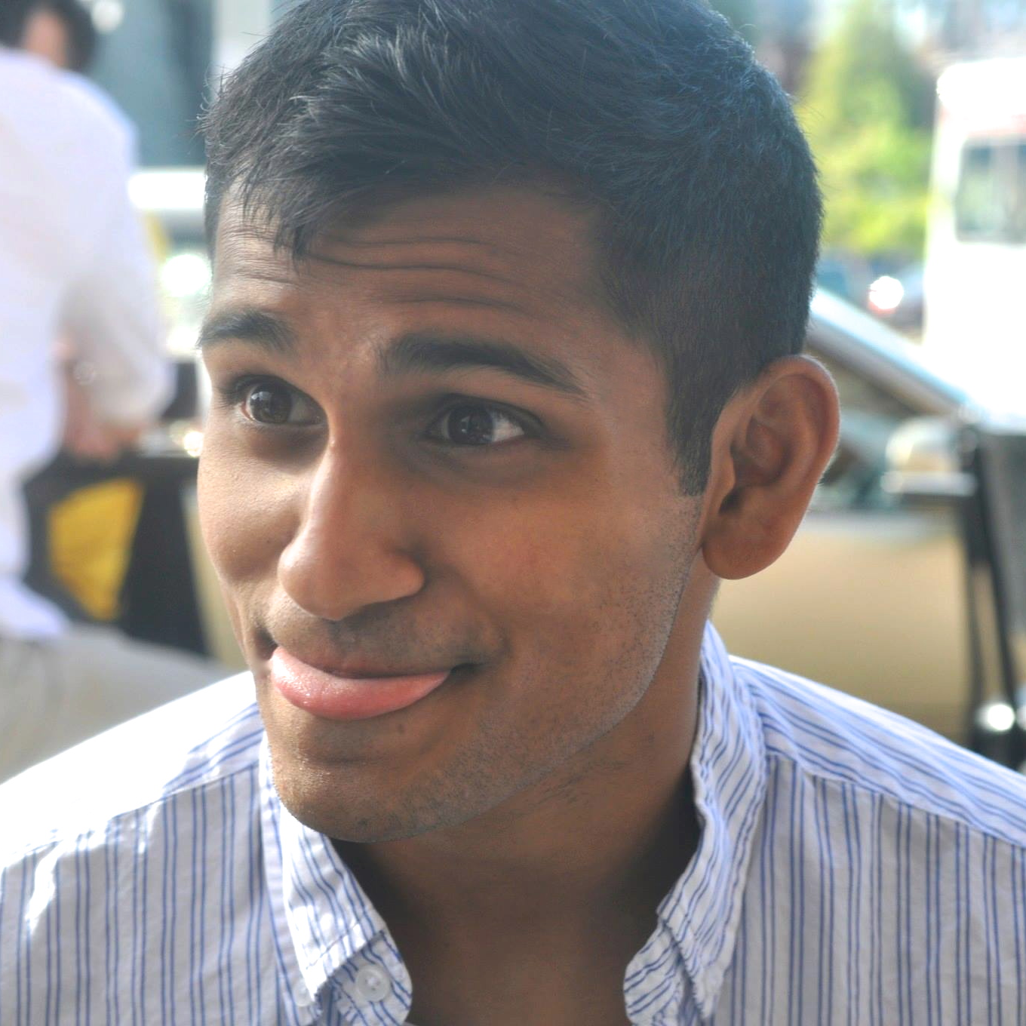
Ankit Shah
Age: 24
Founder, Tea with Strangers
“the most important thing about creative ideas is remembering a few key context points about where they came from.”

Slide 8
Empathy Map:
SAY:
DO:
“Kerning sucks”
“I love big notebooks and I like extra space.”
Drew a web of interactions
“A lot of people in my field spend an atrocious amount of time on Tumblr and Pinterest, a lot of them do a ludicrous research. My process is more...organic.”
Doesn’t put stuff in her portfolio
“I like mobile code updates because it allows me to not be stuck in front of my computer.”
Building a treehouse to live in
Uses post-its to brainstorm names
“I know I could use Carousel or the dropbox app, but they kind of suck.”
Made a giant city collage of the French city of Marseilles
“Text is useful for images because you can contextualize.”
When in Europe, had to wait to get home to share
“Remembering a few anchors of the idea is important”
Jots inspiration in notebooks
“Every time I want to use photoshop or illustrator there is some sort of update that I need to install and it takes 15 minutes.”
Sends photos of things he’s built
“I think it’s more fun to do it yourself.”
Writes in “x” reminded me of “y” and it makes me think of “z”
Carved poster into a slab of granite, then built a campfire next to it and then took a photo of it
“So many applications are geared towards superficial content creation that ends up forgotten weeks later.”
Keeps notebook in back pocket
THINK:
FEEL:
The most important ideas aren’t ideas that you can perfectly illustrate or write
Frustration when using phone
Disgusted by “fake content”
Good design is too time-consuming
Everybody knows what app I used
Appreciation for beauty of hand lettering
Other designers are pissy and don’t like to talk about design process.
Spontaneous when deciding to work on a project
Sharing is all about genuine moments with close family and friends.
Hate for lack of layers on mobile design apps
Even 5% bad is unusable
Superiority over designers who are locked into their methods
Coming up with ideas is an internal, not external, process.
Excitement when finding inspiration
Opposed to sharing highly filtered/edited lives
Annoyance at software overhead of Creative Cloud
It would be cool if I had better accessibility to my stuff.
Proud of status as somebody who breaks the mold
Ideas are hard to preserve outside the brain
Gratitude for spontaneity of inspiration

Slide 9
SAY:
“Kerning sucks”
“I love big notebooks and I like extra space.”
“A lot of people in my field spend an atrocious amount of time on Tumblr and Pinterest, a lot of them do a ludicrous research. My process is more...organic.”
“I like mobile code updates because it allows me to not be stuck in front of my computer.”
“I know I could use Carousel or the dropbox app, but they kind of suck.”
“Text is useful for images because you can contextualize.”
“Remembering a few anchors of the idea is important”
“Every time I want to use photoshop or illustrator there is some sort of update that I need to install and it takes 15 minutes.”
“I think it’s more fun to do it yourself.”
“So many applications are geared towards superficial content creation that ends up forgotten weeks later.”

Slide 10
DO:
Drew a web of interactions
Doesn’t put stuff in her portfolio
Building a treehouse to live in
Uses post-its to brainstorm names
Made a giant city collage of the French city of Marseilles
When in Europe, had to wait to get home to share
Jots inspiration in notebooks
Sends photos of things he’s built
Writes in “x” reminded me of “y” and it makes me think of “z”
Carved poster into a slab of granite, then built a campfire next to it and then took a photo of it
Keeps notebook in back pocket

Slide 11
THINK:
The most important ideas aren’t ideas that you can perfectly illustrate or write
Good design is too time-consuming
Everybody knows what app I used
Other designers are pissy and don’t like to talk about design process.
Sharing is all about genuine moments with close family and friends.
Even 5% bad is unusable
Coming up with ideas is an internal, not external, process.
Opposed to sharing highly filtered/edited lives
It would be cool if I had better accessibility to my stuff.
Ideas are hard to preserve outside the brain

Slide 12
FEEL:
Frustration when using phone
Disgusted by “fake content”
Appreciation for beauty of hand lettering
Spontaneous when deciding to work on a project
Hate for lack of layers on mobile design apps
Superiority over designers who are locked into their methods
Excitement when finding inspiration
Annoyance at software overhead of Creative Cloud
Proud of status as somebody who breaks the mold
Gratitude for spontaneity of inspiration

Slide 13
Challenges:
Hayward finds it challenging to “seek inspiration.”
Jenny finds it challenging to properly record authentic life experiences.
Katherine finds it challenging to bring her designs with her.
Ankit finds it challenging to properly record inspiration.

Slide 14
Inferences:
Jenny and Ankit share a problem: recording experiences leads to losses in translation.
Hayward and Ankit share a design belief: inspiration is best when organic.

Slide 15
Potential Tension?
Katherine has a hard time bringing her designs out into the world, while the others seem to have a hard time bringing inspiration back in.

Slide 16
We know: The world is changing fast.
In particular: People move more.
How might we leverage this shift to enable people to be more creative?
We Noticed: People getting to see more increases opportunities for organic inspiration!
We believe: It would be game-changing if designers could seamlessly bring inspiration from the real world home with them in an authentic way.

